Slide 1
Project Plan Quadcopter Drone
Project in Electrical Engineering
Jonas Gartner Sigge Axelsson
September 10, 2024
Notes:
Jonas

Slide 2
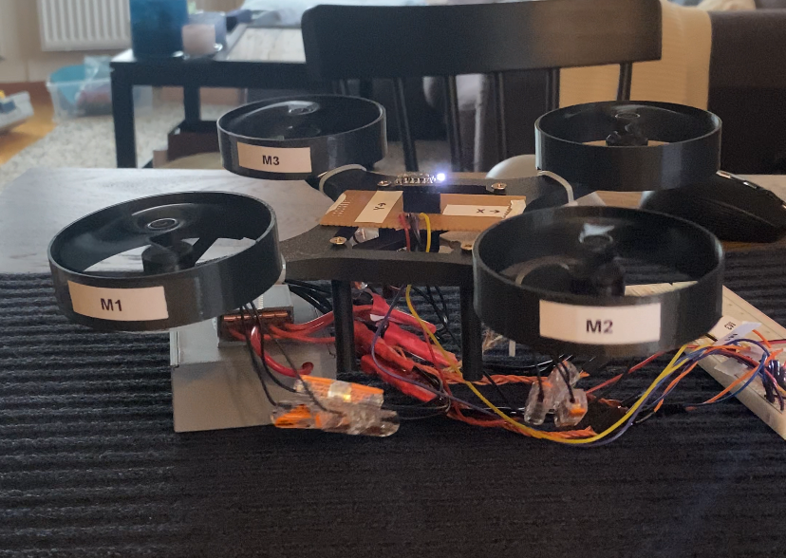
Recap 5HP course Overview and Objectives
Goals
Construct a simple drone using off the shelf components that is capable of hovering for a few seconds
Purpose
Gain knowledge for larger 15HP project
Notes:
Jonas

Slide 3
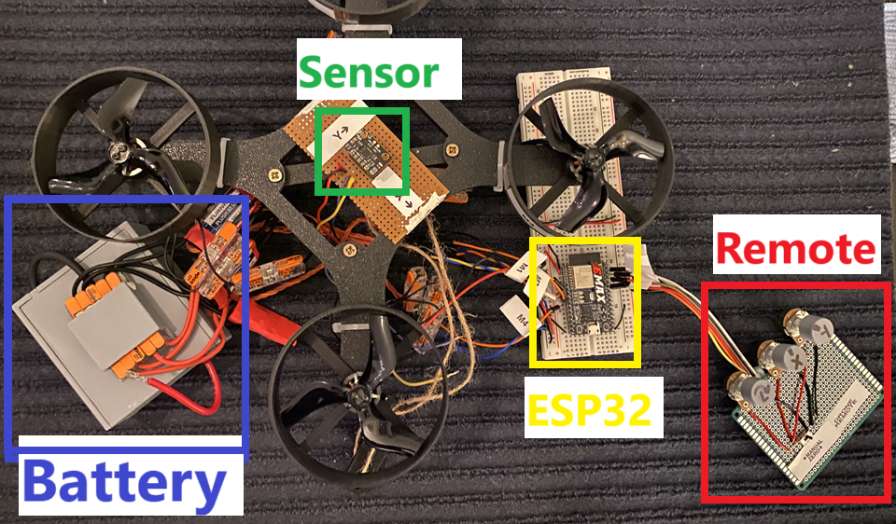
Recap 5HP course Results
ESC
Notes:
Jonas

Slide 4
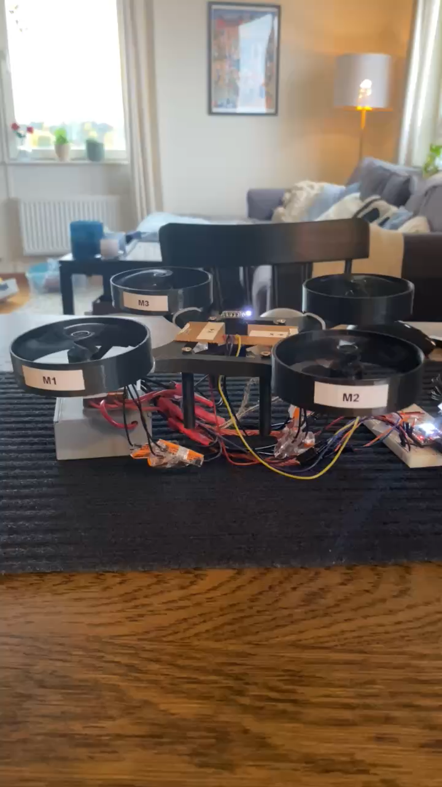
Recap 5HP course Results
Hover Test Results
The drone was able to hover briefly, but performance was limited
Identified Challenges
Wired setup imposed physical constraints
Flight dynamics and balancing capabilities were impacted
Notes:
Jonas

Slide 5
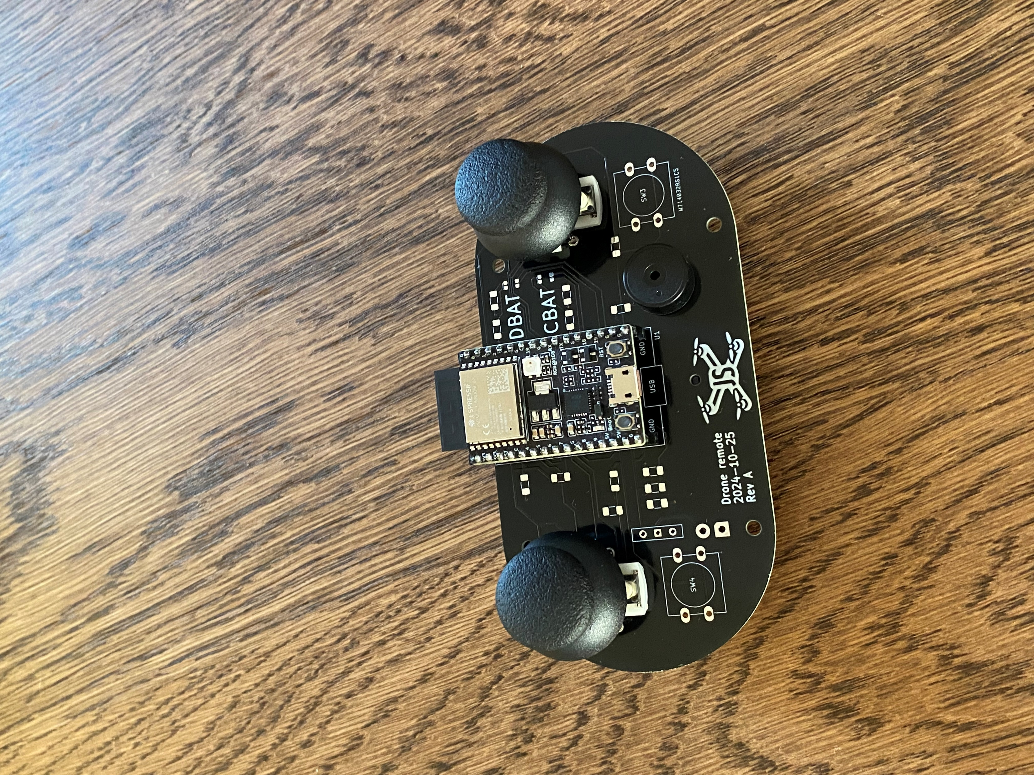
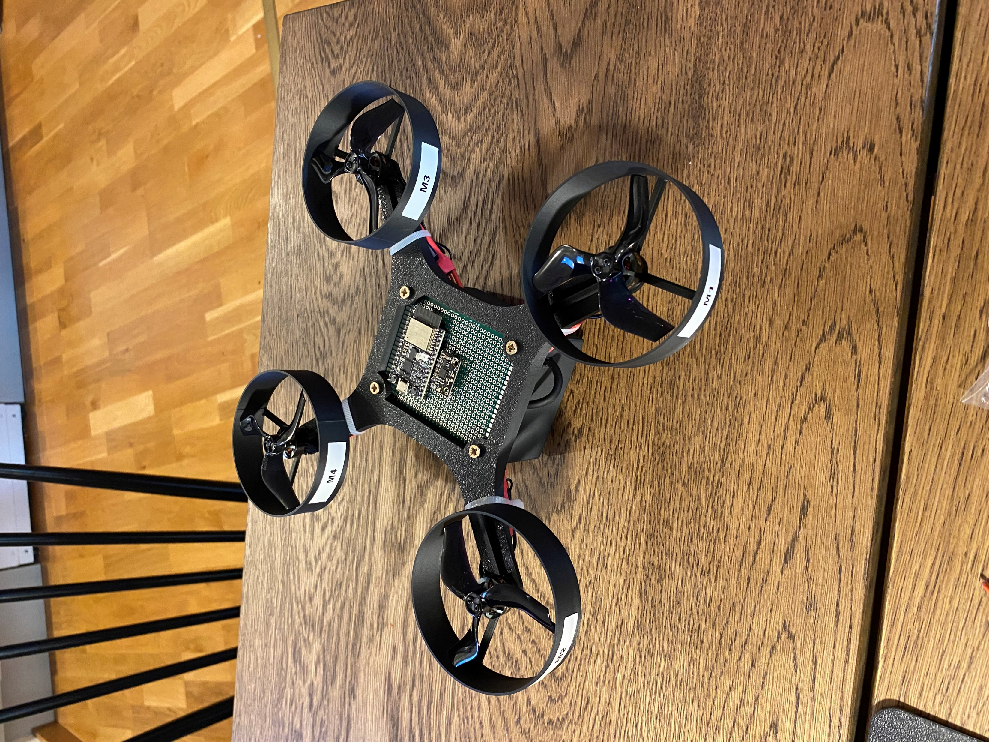
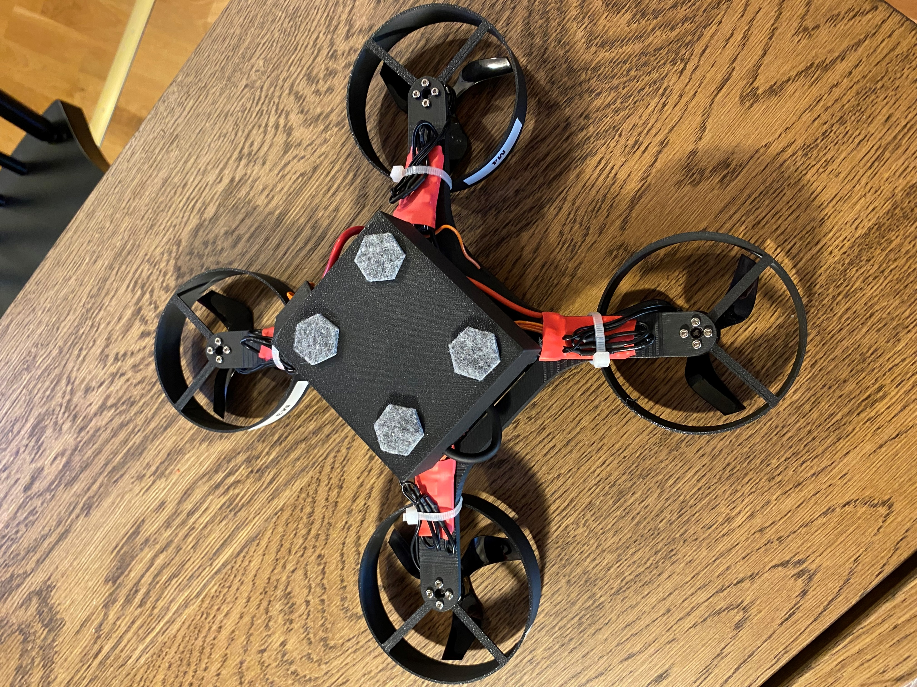
15 HP Course Progress
Notes:
Jonas

Slide 6
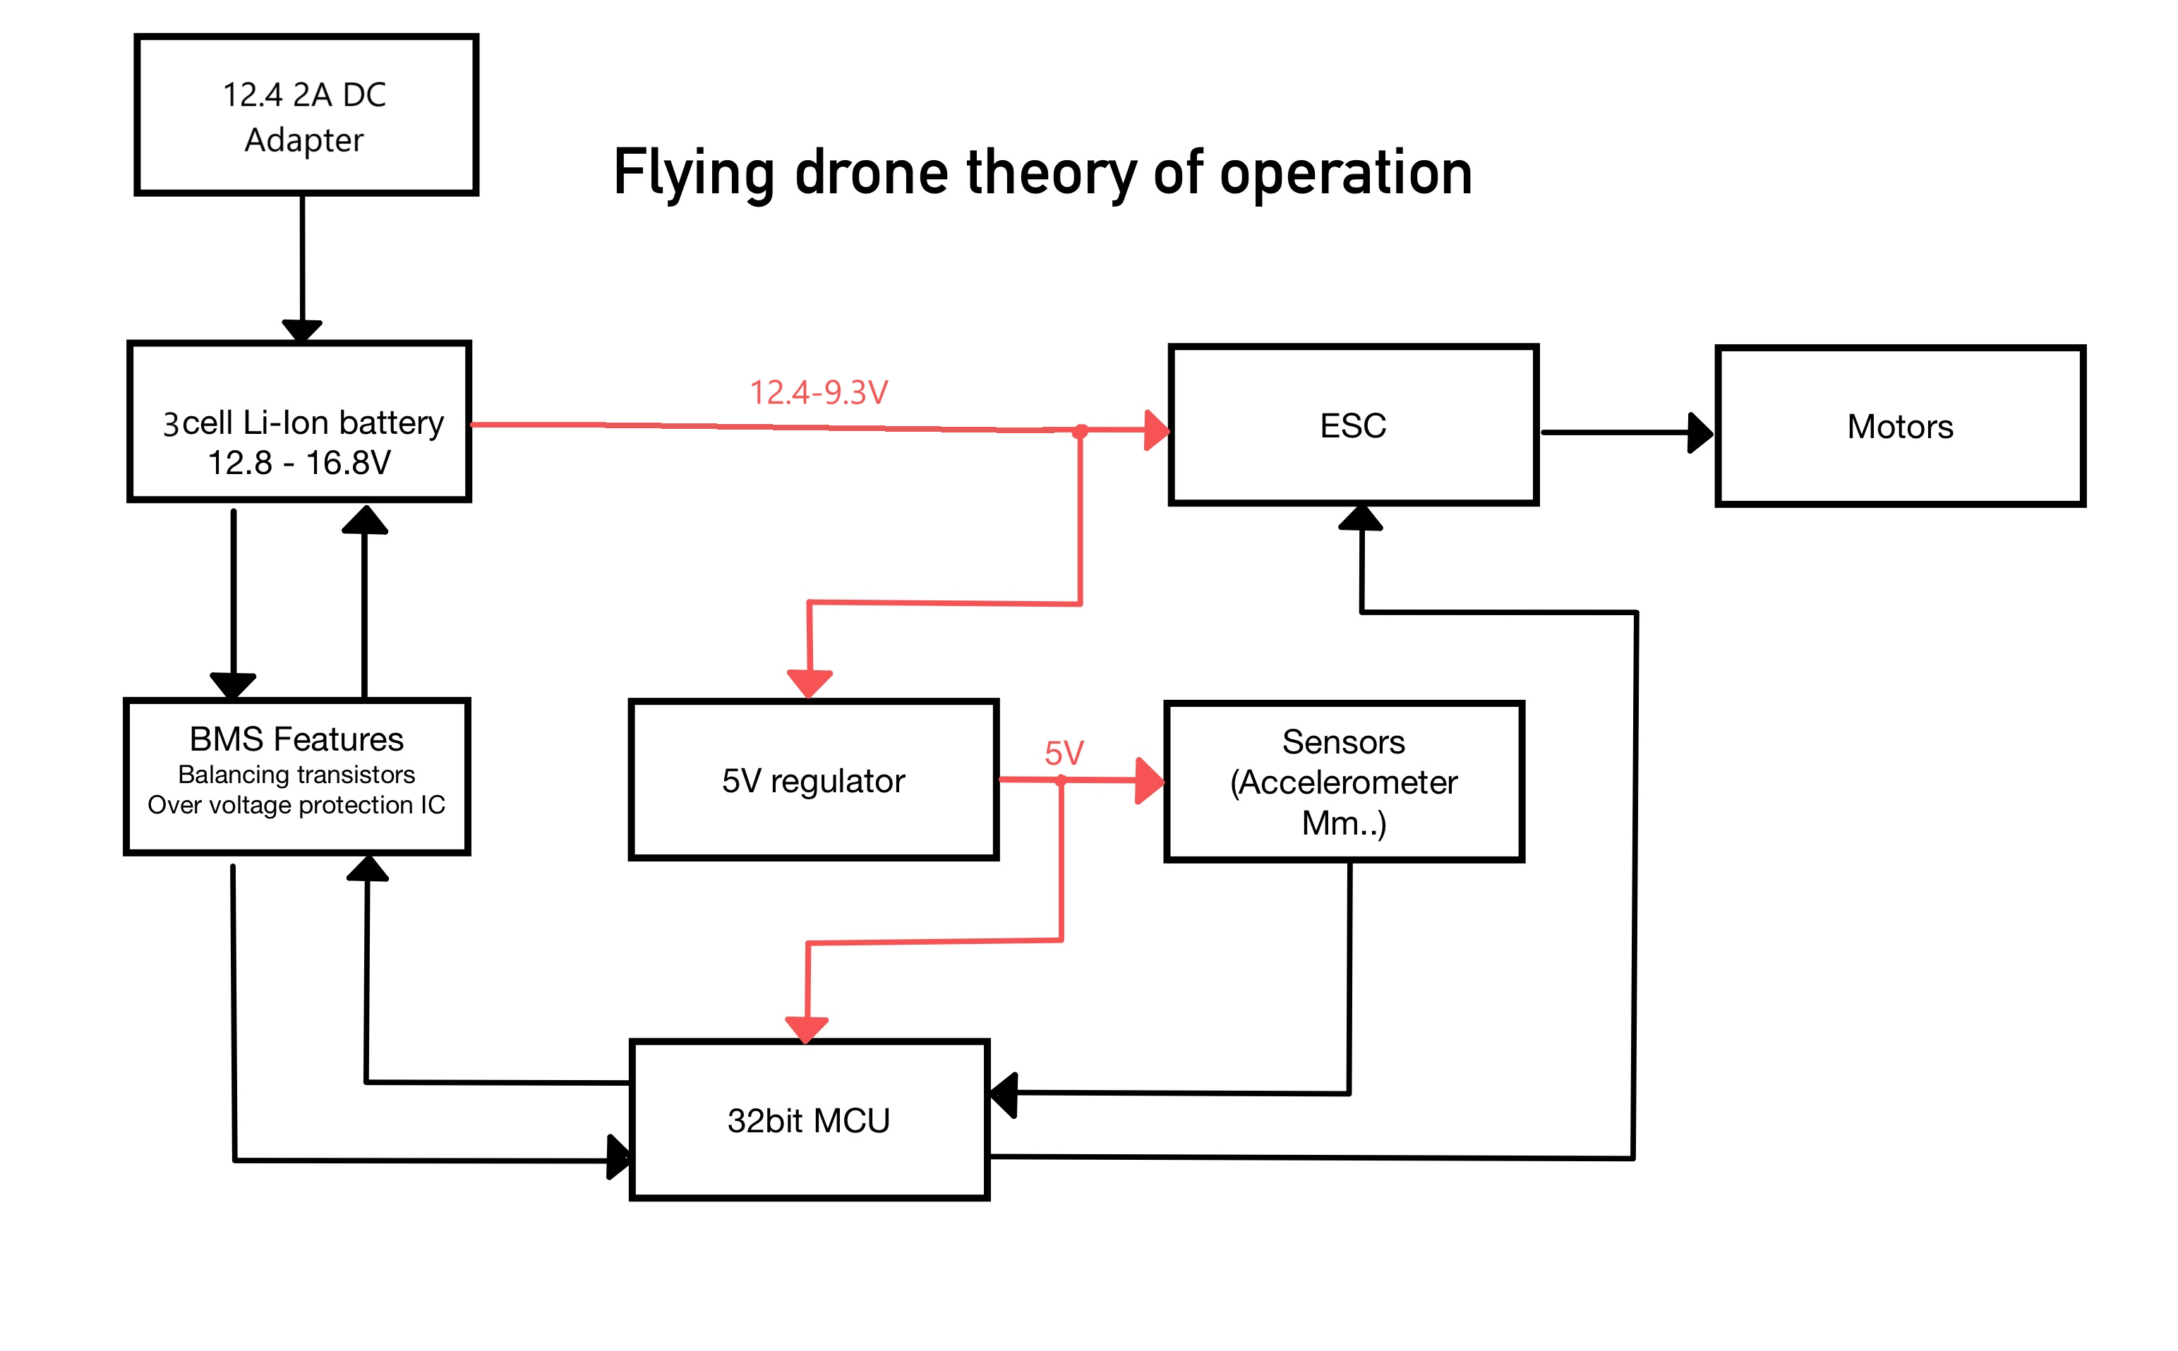



15 HP Course Block Diagram
Notes:
Sigge

Slide 7
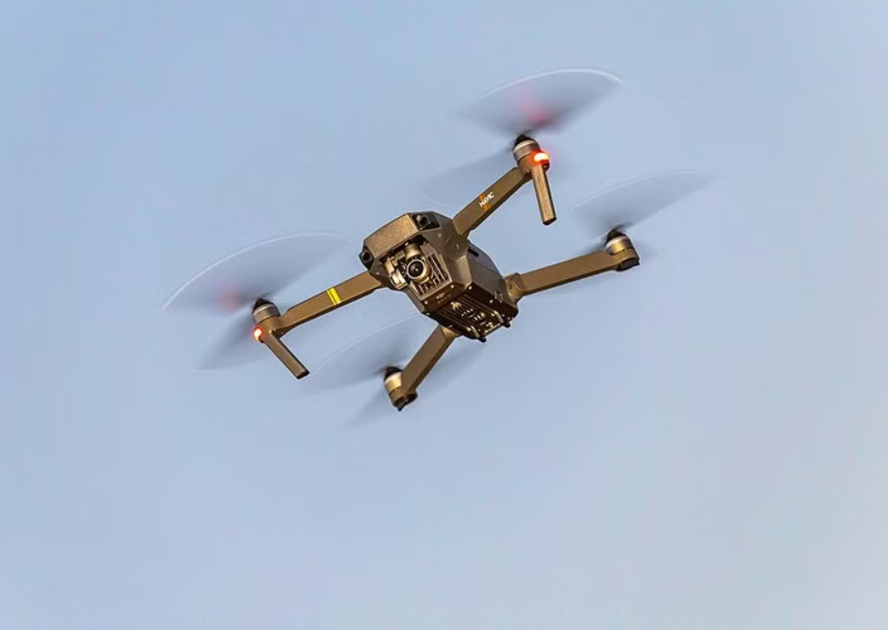
15 HP Course Goals
Goals project course:
Wireless – battery pack, BMS
All electronics constructed from scratch
Custom pcbs
Improved flight controller
Capable of proper flight
Notes:
Sigge

Slide 8
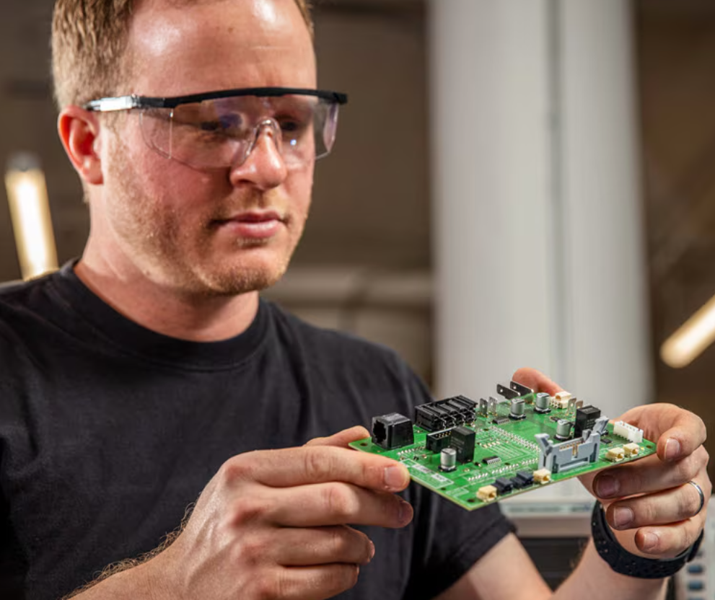

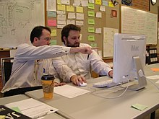
15 HP Course Tasks and Responsibilities
Hardware - Jonas
Flight controller - Sigge
MCU programming - shared
Notes:
Sigge

Slide 9
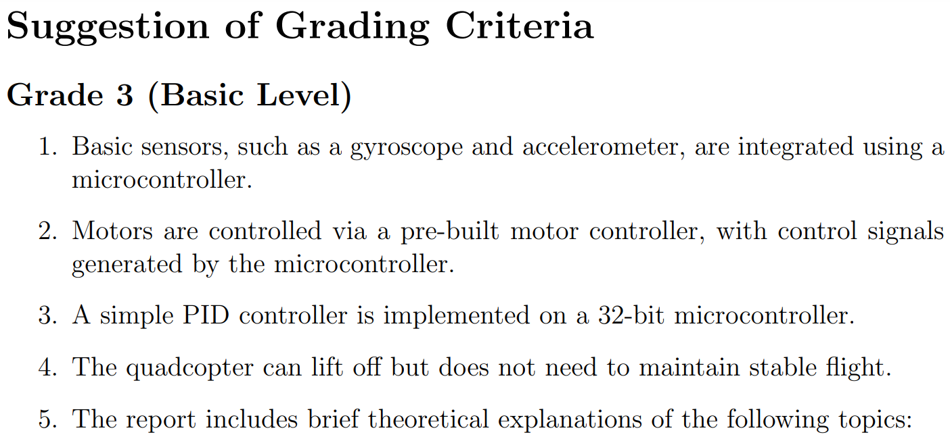
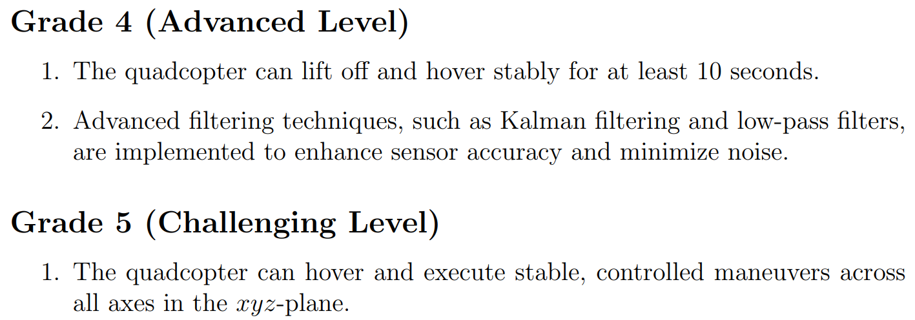
15 HP Course Grading
.
.
.
Notes:
Sigge

Slide 10
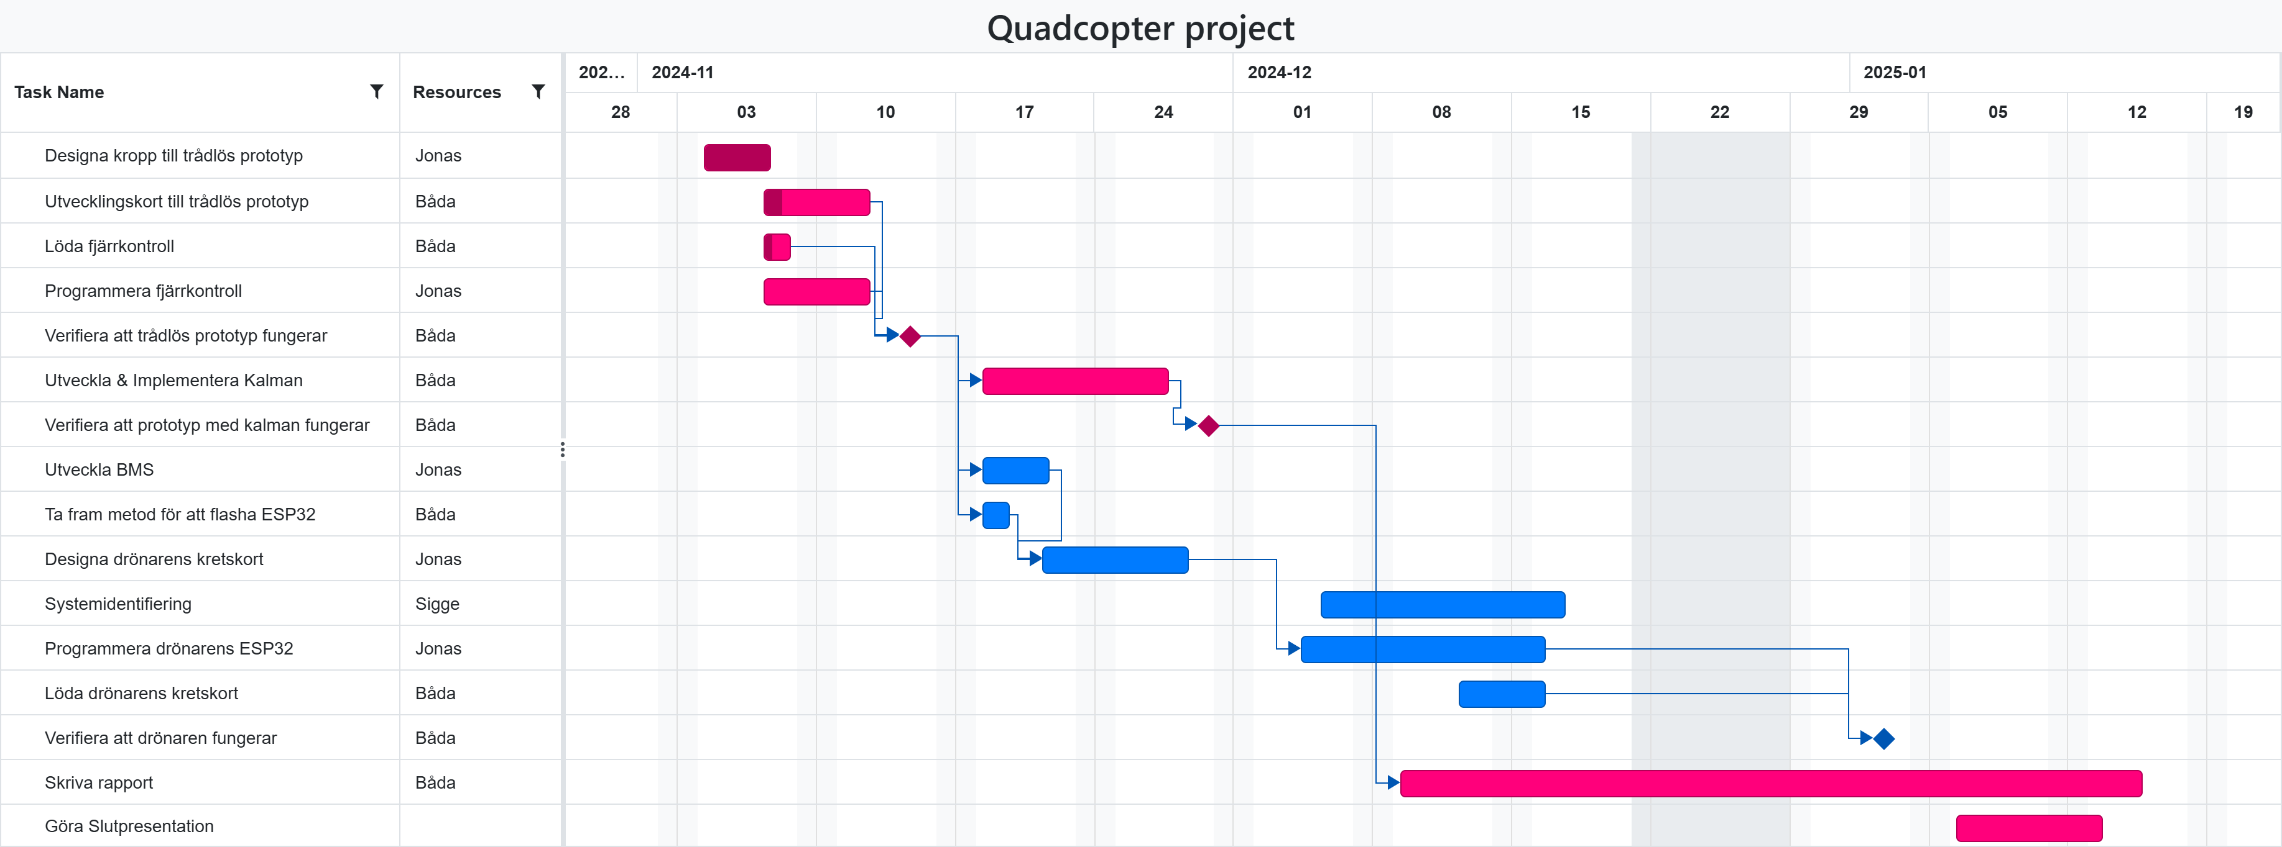
15 HP Course Time Schedule
Critical for passing
Optional
Notes:
Jonas

